Slide 1
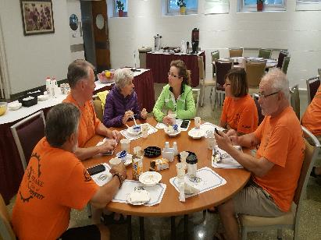
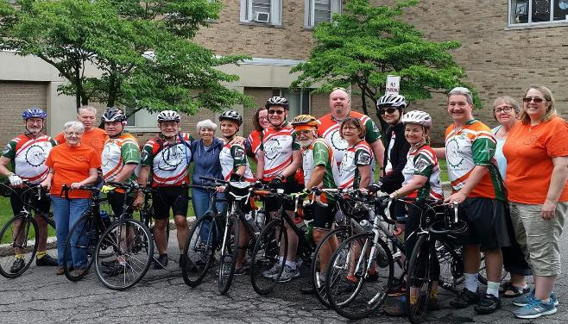
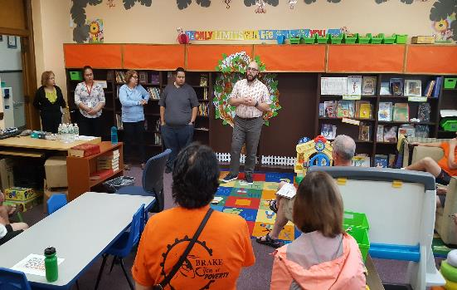
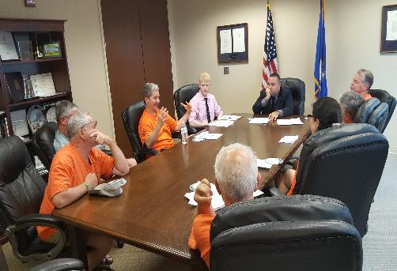
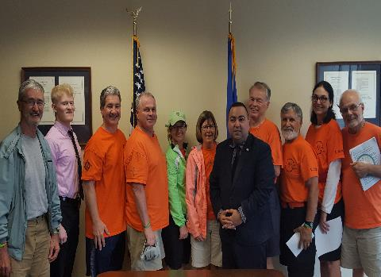
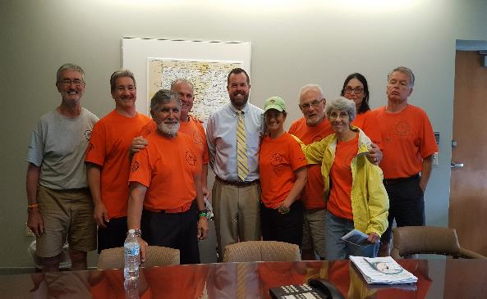
Day 6 2018 - Holy Family to Southside Family Center to Blumenthal to Murphy to Community Resource Center to St. Bridget
Breakfast at Holy Family
All at Holy Family
Learning at Southside
With Joe Rodrigues (Blumemthal’s)
with Kenny Curran (Murphy’s)

